Slide 1
GO TEAM MEETING #1
Peyton Forest Elementary School

Slide 2
TOPICS
School Strategic Plan
Strategic Plan & Priorities Review
SMART Goals
Data Discussion
Spring MAP
GMAS
Principal’s Report
Current Enrollment & Leveling
Information about our school

Slide 3
2021-2025 STRATEGIC PLAN

Slide 4
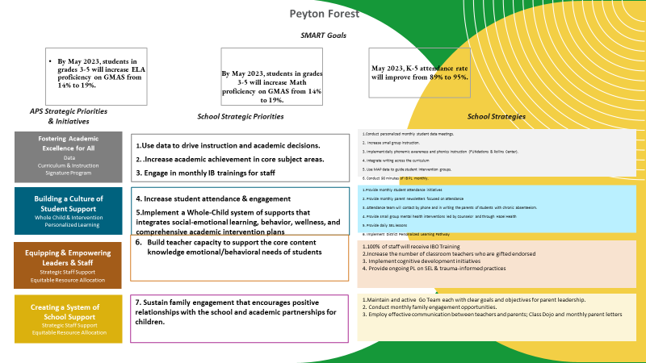
West Manor IB World School
SMART Goals
Increase the % of grades 3-5 students scoring proficient or above on Milestones/ MAP in reading by 3%
Increase the % of grades 3-5 students scoring proficient or above on Milestones/MAP in math by 3%
Increase the percentage of students with 10 or less absences by 3%
APS Strategic Priorities & Initiatives
School Strategic Priorities
School Strategies
Fostering Academic Excellence for All
Data
Curriculum & Instruction
Signature Program
1.
3.
1A. Implementation of an intervention block to reduce gaps in learning
1B. Employ a literacy block with phonics for grades k-2
1C. Create PLC planning time for teachers to internalize standards and plan for instruction
Increase student phonic awareness and create early readers
Increase student knowledge in numbers and operations domain
Increase student multiplication skills
Building a Culture of Student Support
Whole Child & Intervention
Personalized Learning
Increase student attendance and decrease suspension rate
TBD: Create an attendance team to monitor and address attendance concerns, Create a Care Team to address student needs
TBD: Utilize SLC practices and restorative justice with the Counselor to reduce suspensions
Equipping & Empowering Leaders & Staff
Strategic Staff Support
Equitable Resource Allocation
Increasing Teacher knowledge of Standards
Increase Teacher knowledge of IB Program
TBD: Monthly IB training for staff, Professional development individualized around teacher needs in reading and math, training for phonics program (Fundations)
Ongoing PD for SEL, restorative practices, and trauma
Creating a System of School Support
Collective Action, Engagement & Empowerment
TBD: Conduct data meetings in PLC, with parents and students. Students will also have goal setting meetings with teachers
--Increase Parent Liaison and Social Worker positions to full time to support the needs of students and parents
Improve stakeholder knowledge of school data and how to assist
Provide support to students and stakeholders in need

Slide 5
Strategic Plan
Priority Ranking
Insert the school’s priorities from Higher to Lower
Higher
1.Increase student phonic awareness and create early readers
2 Increase student knowledge in numbers and operations domain
3. Increase student multiplication skills
4. Increase student attendance and decrease suspension rate
5.Increasing Teacher knowledge of Standards
Increase Teacher knowledge of IB Program
7. Improve stakeholder knowledge of school data and how to assist
9. Provide support to students and stakeholders in need
Lower

Slide 6
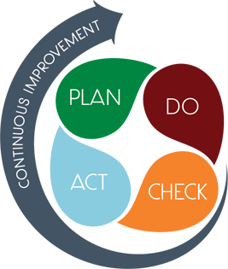
CONNECTING THE STRATEGIC PLAN & CONTINUOUS IMPROVEMENT PLAN
1.Increase student phonemic awareness and create early readers
Increase student proficiency on ELA assessments by 3%
Milestones and MAP Scores
2. Increase student knowledge of new math standards
Increase student proficiency on Math assessments by 3%
Milestones and MAP Scores
Improve student attendance
Increase average attendance rate from 89% to 95%
CCRPI Attendance Rate

Slide 7
DATA DISCUSSION

Slide 8
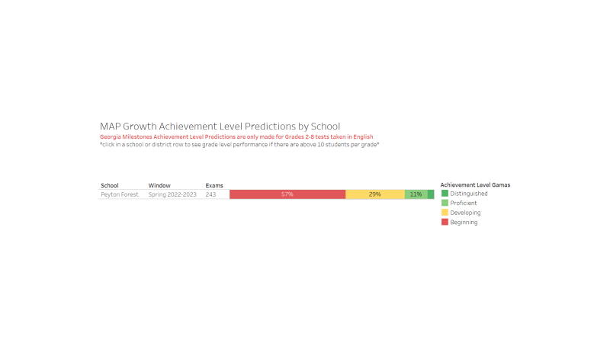
SPRING ELA MAP RESULTS

Slide 9
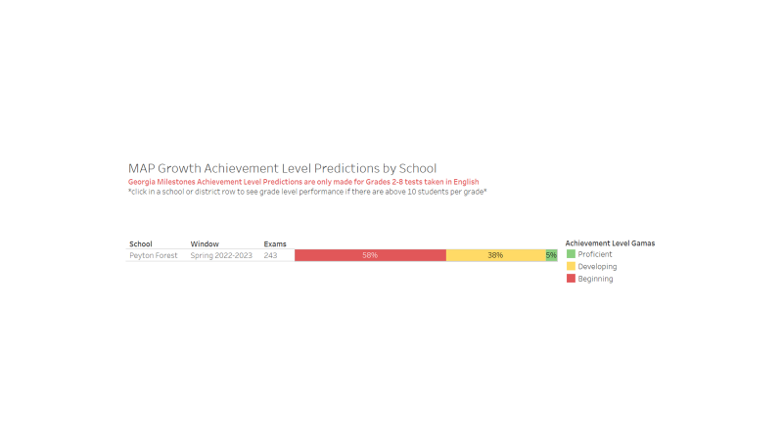
SPRING MATH MAP RESULTS

Slide 10
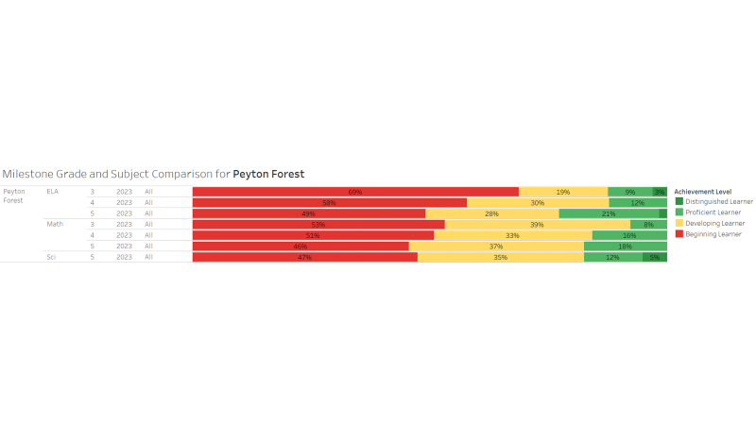
GMAS RESULTS

Slide 11
GLOWS & GROWS
GLOWS
GROWS
Overall Proficiency rates are higher in 2023 than 2022 in ELA and Science by Black students and students in 3rd grade
In math, 5th grade proficiency rates are higher overall and by HIspanic students.
In ELA, 4th grade proficiency rates are lower than in 2022.
In Math, 3rd and 4th grade student proficiency rates are lower.
IMPACT

Slide 12
GO TEAM DISCUSSION: DATA PROTOCOL
What do you notice?
What are your wonderings?
What additional questions do you have?

Slide 13
Timeline for GO Teams
You are HERE
1
2
3
4
5
Fall 2021
GO Team Developed 2021-2025 Strategic Plan
Summer
School Leadership completed Needs Assessment and defined overarching needs for SY22-23
August
School Leadership completed 2022-2023 Continuous Improvement Plan
Sept. – Dec.
Utilizing current data, the GO Team will review & possibly update the school strategic priorities and plan
Before Winter Break
GO Team will take action (vote) on the rank of the strategic plan priorities for SY23-24 in preparation for budget discussions.

Slide 14
QUESTIONS?

Slide 15
PRINCIPAL’S REPORT

Slide 16
ENROLLMENT
Projected Enrollment | 336
Current Enrollment | 282
Difference | 54
LEVELING
Leveling is the process the District uses to adjust school budget allocations to match student enrollment.
Budget Impact | (Principal: input change in allocation for your school and discuss how you are going to address the change in allocation)
Notes:
Principals: Based on your enrollment, please give your GO Team the information on how you plan to account for any budget changes due to leveling.

Slide 17
ANNOUNCEMENTS

Slide 18
Hispanic Heritage Month
ROAR Rally
Report Card Parent Conferences

